Slide 1
agentic ai for personalized course pathways
CAPSTONE PROJECT
Presented By:
1. Geetha - Srinivasa Institute of Engineering and Technology- AIML

Slide 2
OUTLINE
Problem Statement (Should not include solution)
Proposed System/Solution
System Development Approach (Technology Used)
Deployment
Result (Output Image)
Conclusion
Future Scope
References

Slide 3
Problem Statement
Students often struggle to identify the right learning path that aligns with their interests and long-term goals due to the overwhelming number of online courses and a lack of personalized guidance. LearnMate aims to solve this by acting as an Agentic AI coach that interacts with students, understands their interests (like Frontend Development, Cybersecurity, UI/UX Design, etc.), assesses their current skill level, and dynamically builds a personalized course roadmap that adapts over time based on progress and preferences.

Slide 4
Proposed Solution
The solution that aims to address the challenge of helping students find the right learning pathway based on their interests, skill level, and career goals. This involves using LLM (Granite model) and IBM tools to dynamically generate personalized course roadmaps.
Data Collection:
Understand student interests through natural language input
Use external sources (Google, Wikipedia tools ) to enrich responses and suggest updated content.
Data Preprocessing:
Use IBM Granite model to interpret user queries and generate customized learning paths.
Deployment:
Deploy the AI agent on IBM Watsonx.ai using Granite-3.3-8b-instruct model.
Enable tools like Google Search and Wikipedia for dynamic responses.
Make the interface user-friendly and accessible from web or mobile.
Evaluation:
Collect user feedback (optional future scope) to improve roadmap suggestions.
Ensure suggestions remain aligned with real-time trends in tech and industry jobs.
Result:
A fully functional Agentic AI Career Assistant that provides students with personalized learning paths, real-time guidance, and evolving course suggestions — hosted on IBM Cloud using official Granite models and Watson tools.

Slide 5
System Approach
The system is designed to guide students by recommending personalized learning paths using IBM’s Agentic AI tools. The approach integrates conversational AI (IBM Granite), external tools (Google, Wikipedia), and cloud deployment (Watsonx.ai) to create a fully interactive agent. The process involves the following components:
System requirements
1. IBM Cloud Account
2. Watsonx.ai
3. IBM Granite Model (3.3-8b-instruct)
4. Google/Wikipedia API access
5. Laptop
6. Internet Connection
7. Operating System

Slide 6
Deployment
The agentic ai for personalized course pathways project is deployed using IBM Watsonx.ai and IBM Granite foundation model, following a no-code/low-code approach through the IBM Cloud environment.
Deployment Process :
Created project in Watsonx.ai.
Selected the Granite-3.3-8b-instruct model
Enabled tools: Google, Wikipedia
Associated Watsonx.ai Runtime
Built agent and added interaction prompts
Deployed to IBM Cloud Deployment Space
Tested and previewed the working agent interface

Slide 7
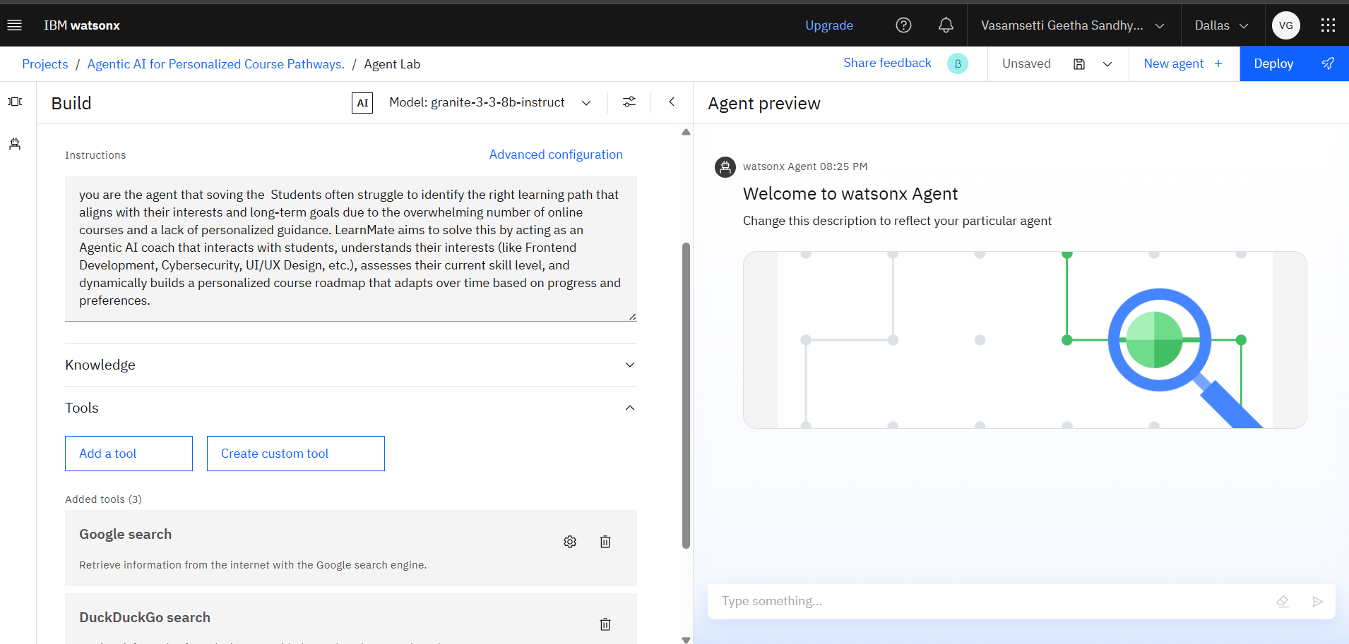
Result

Slide 8
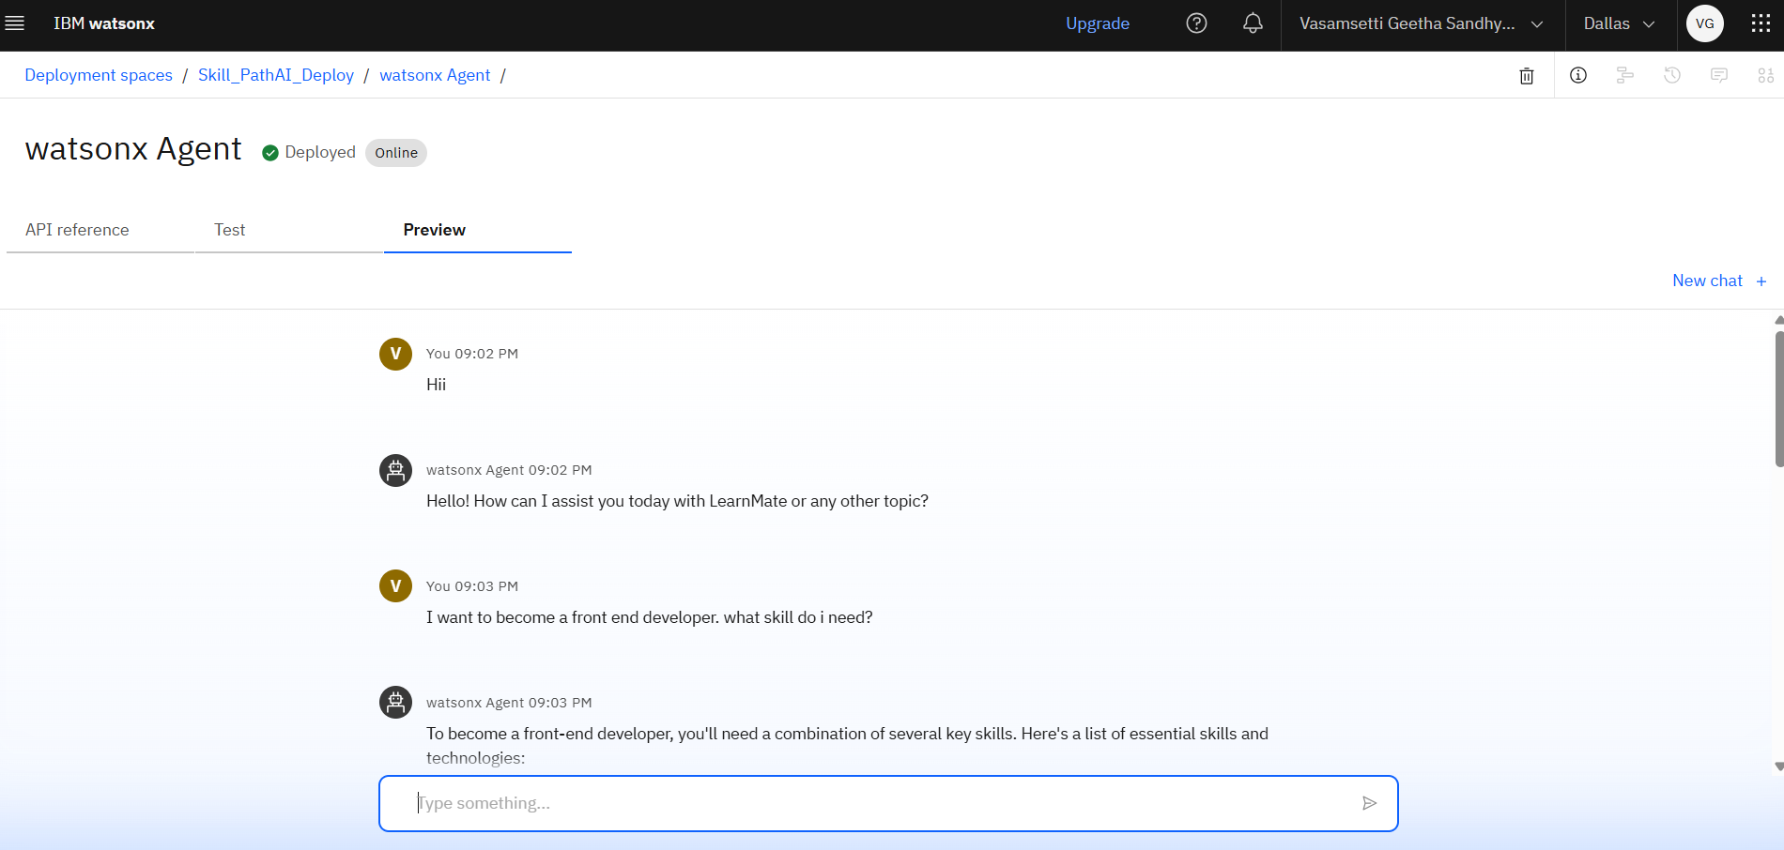
Result

Slide 9
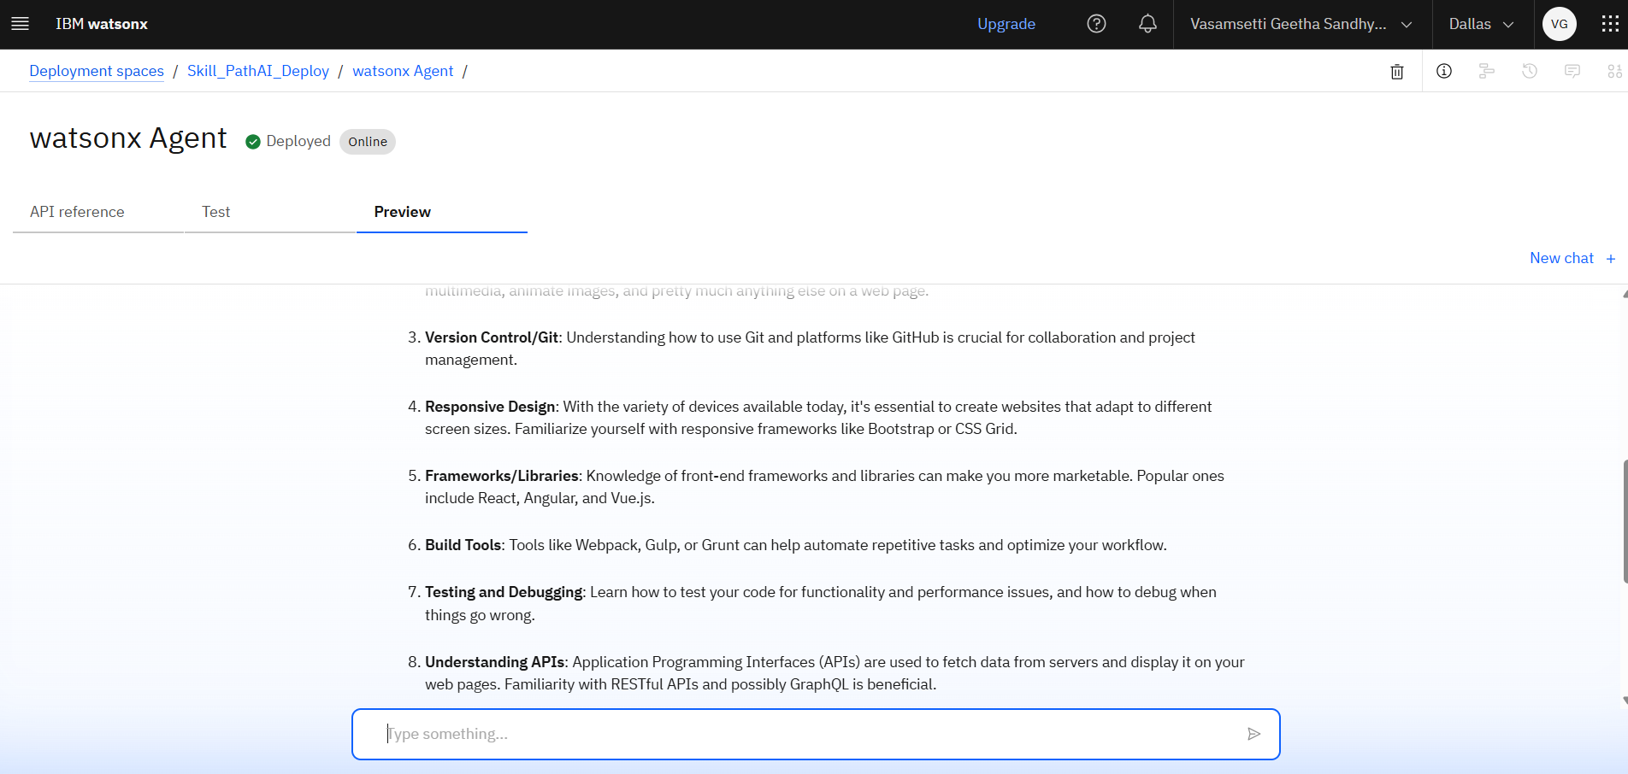
Result

Slide 10
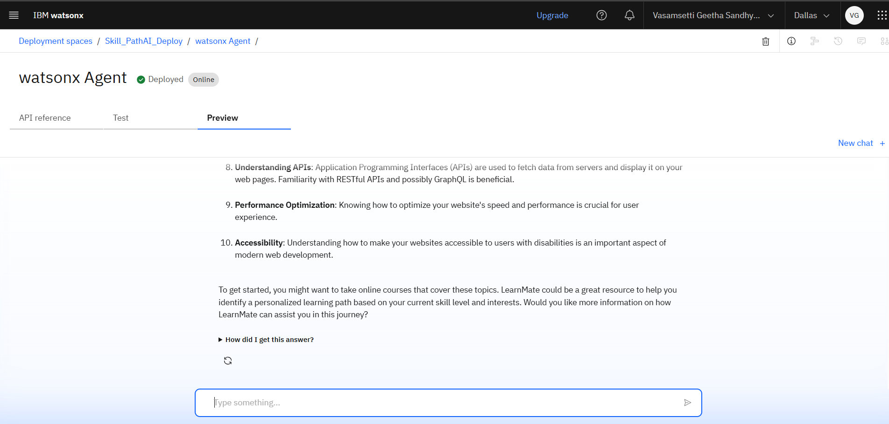
Result

Slide 11
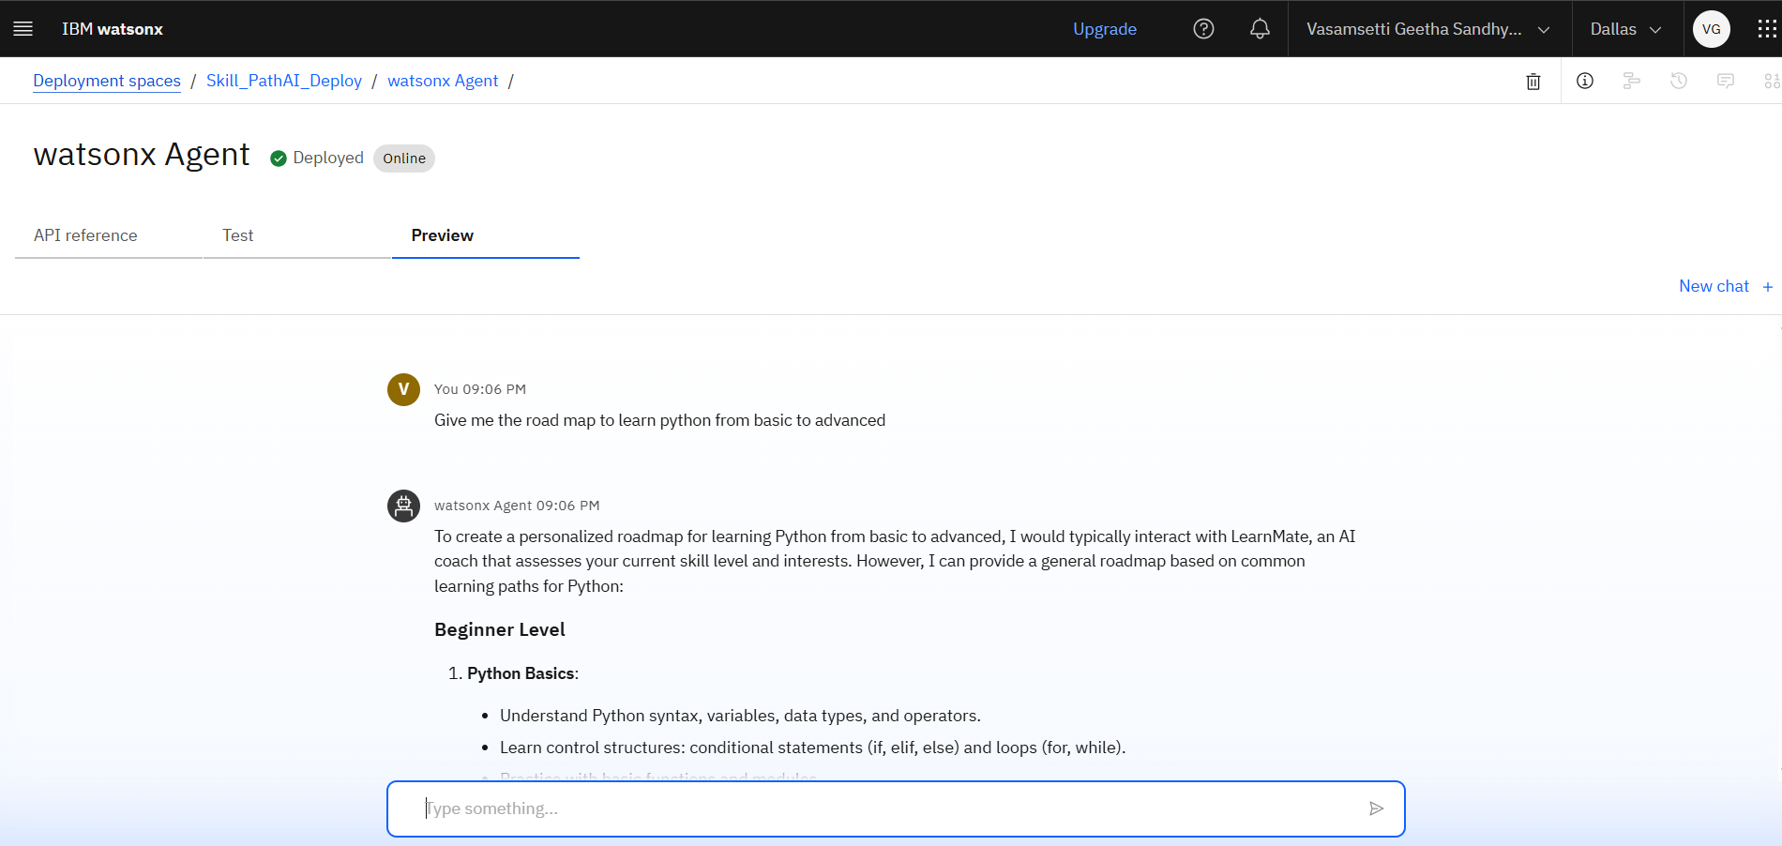
Result

Slide 12
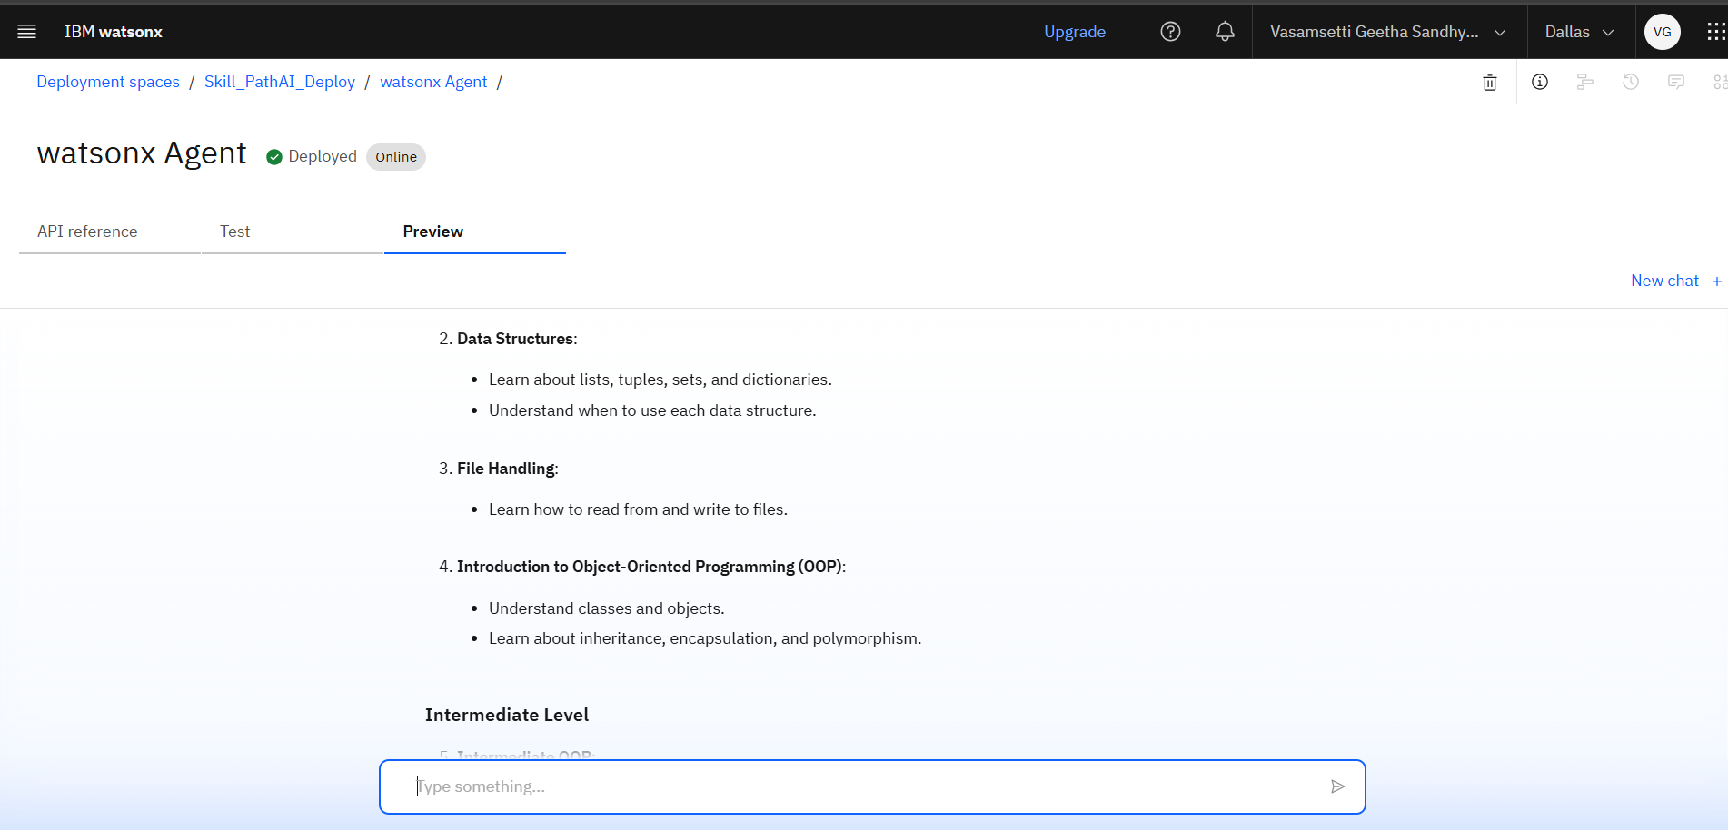
Result

Slide 13
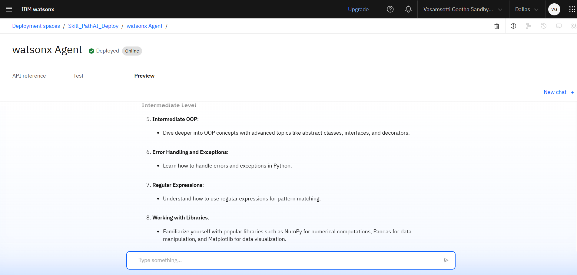
Result

Slide 14
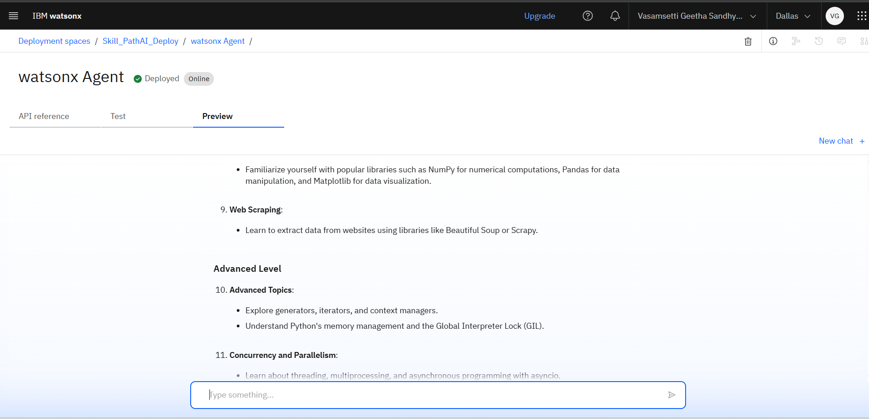
Result

Slide 15
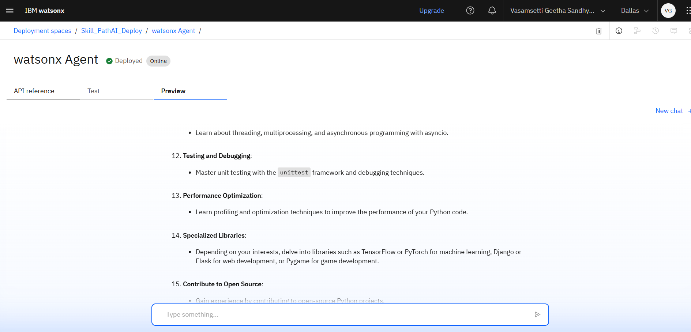
Result

Slide 16
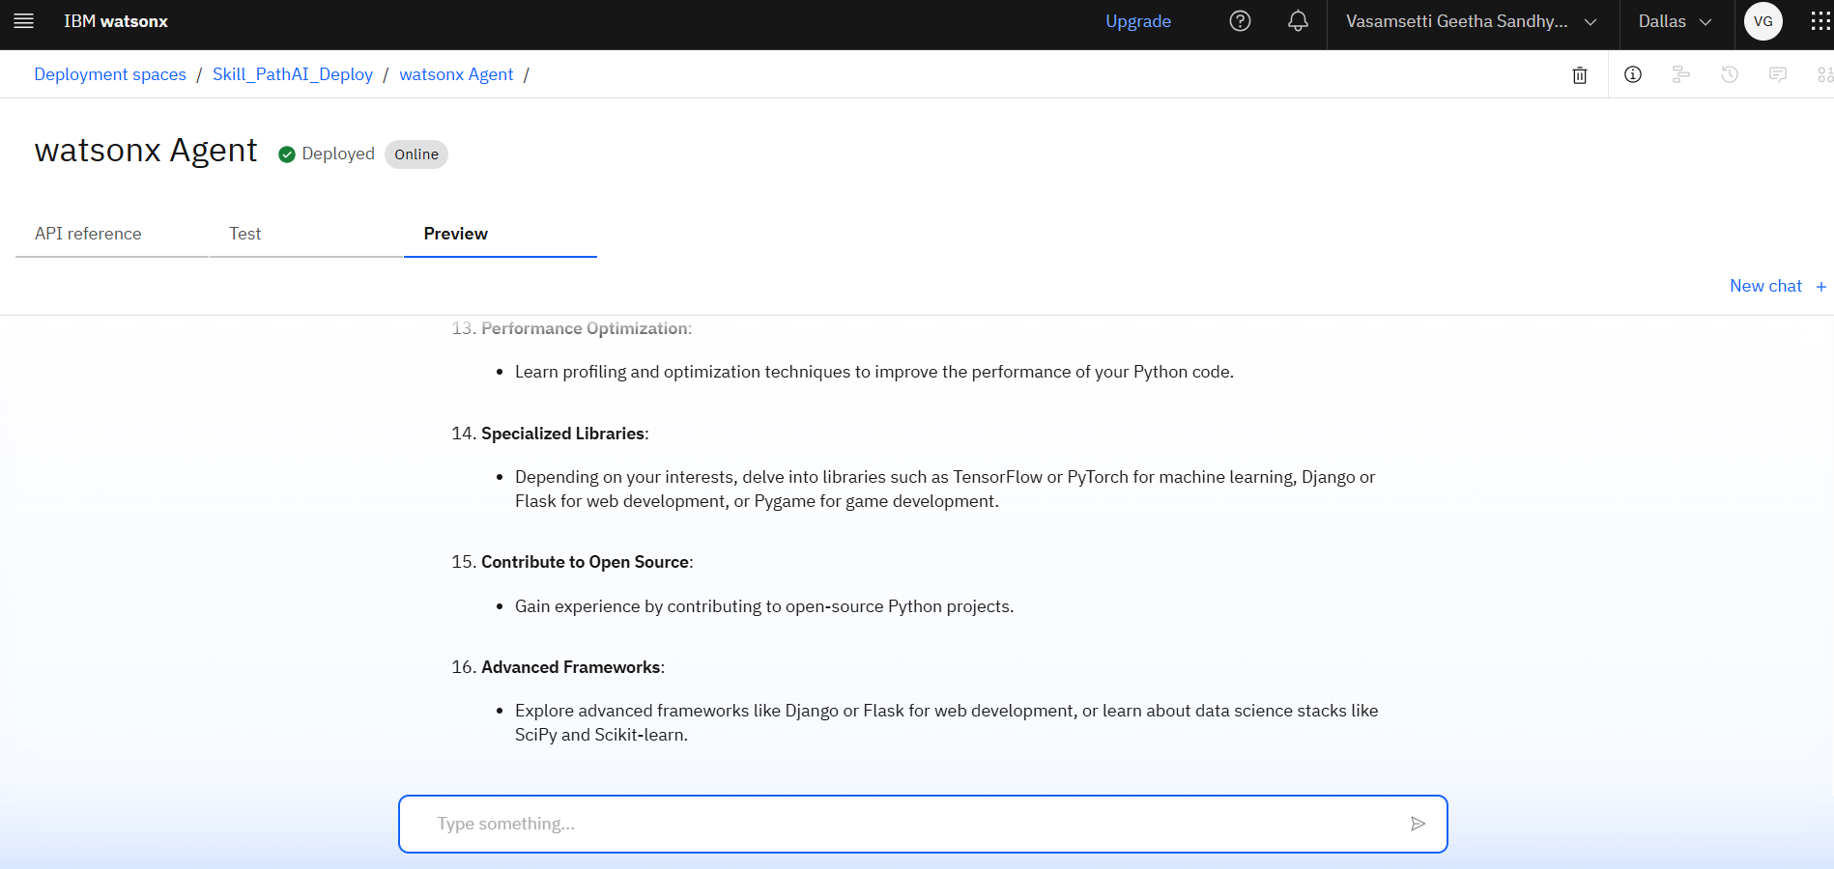
Result

Slide 17
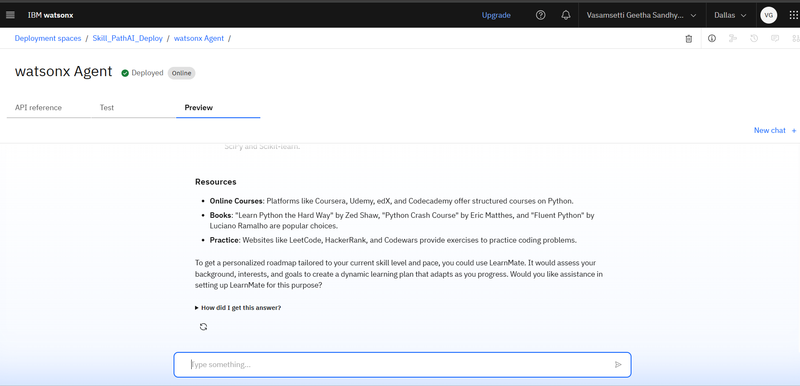
Result

Slide 18
Conclusion
The Agentic AI for personalized course pathways project successfully demonstrates the use of Agentic AI by leveraging IBM Granite's large language model to provide personalized learning pathways for students based on their interests and goals. By deploying the agent on IBM Watsonx.ai and integrating real-time tools like Google Search and Wikipedia, the system offers intelligent, adaptive guidance without requiring custom algorithm development. This solution not only simplifies the course selection process but also showcases the practical potential of AI in education.

Slide 19
Future scope
In the future, Agentic AI for personalized course pathways can be enhanced with voice-based interaction to improve accessibility and ease of use. Integration with popular learning platforms like Coursera, NPTEL, and Udemy through APIs can enable direct course enrollment. The system can also be extended to track user progress, send daily learning reminders, and include interactive quizzes for skill assessment. Additionally, support for multiple regional languages can make the platform more inclusive. Further development could expand LearnMate into a complete career guidance tool, offering job suggestions and internship recommendations based on user interests and learning history.

Slide 20
References
The Agentic AI for personalized course pathways project is developed using IBM Cloud and Watsonx.ai platform, with the Granite-3-3-8b-instruct model provided by IBM for natural language understanding. Information and tools were sourced from IBM’s official documentation and tutorials. External knowledge and course recommendations were supported using tools like Google Search and Wikipedia integration. The project is based on the Agentic AI problem statements provided by IBM SkillsBuild for Academia.

Slide 21
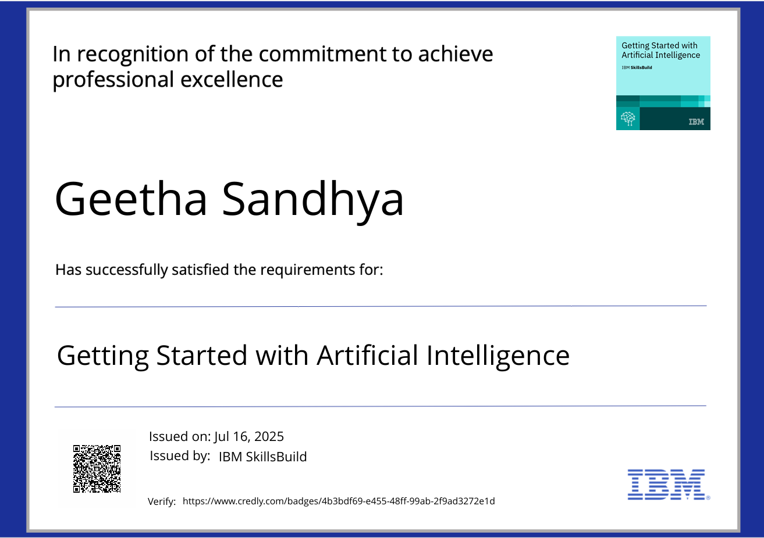
IBM Certifications

Slide 22
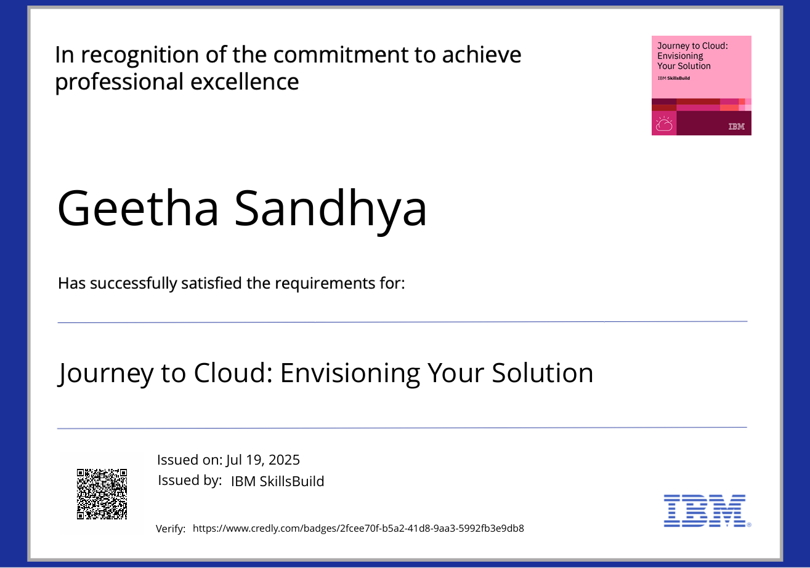
IBM Certifications

Slide 23
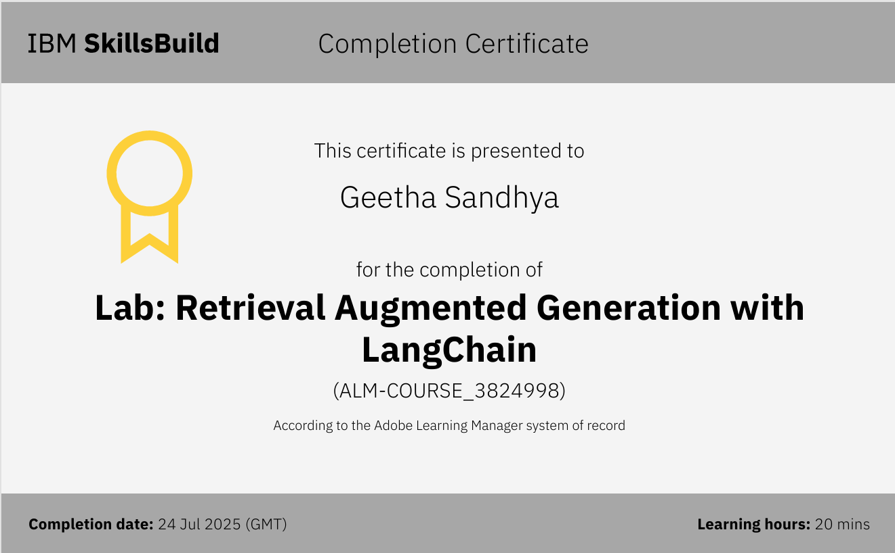
IBM Certifications

Slide 24
THANK YOU

